Slide 1
Mahjong Programming Report
Team: Just For Fun
Xinyu Hu
Kanefumi Matsuyama
Rinyoichi Takezoe

Slide 2
Contents
1
Introduction
2
Offense Algorithm
3
Defense Algorithm

Slide 3
01.
Introduction

Slide 4
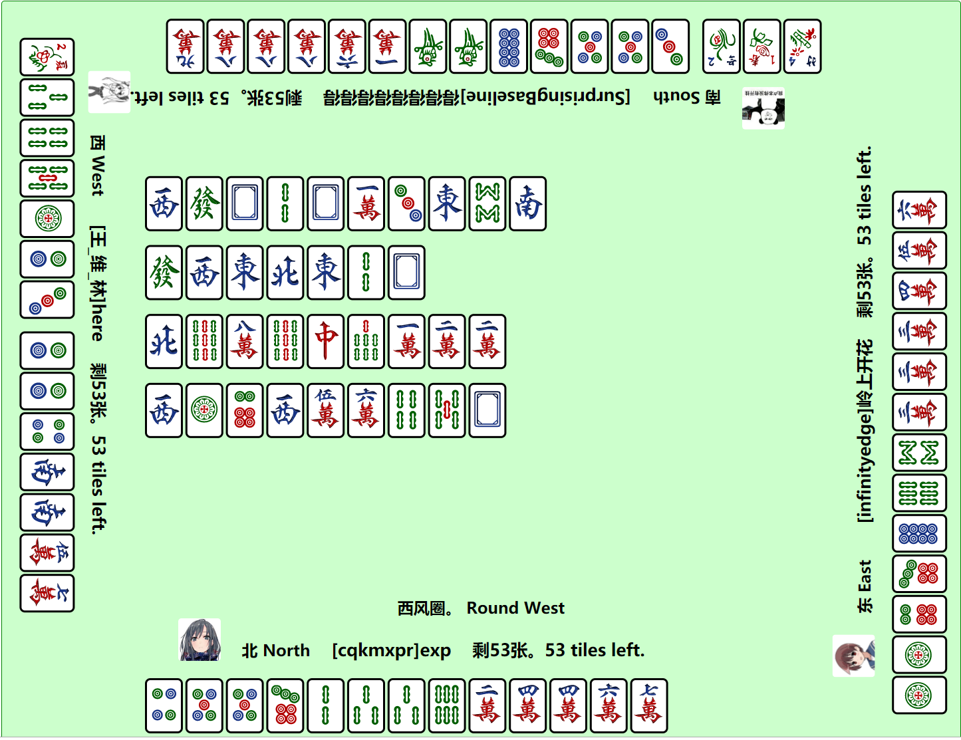
Game Features
Mahjong is a dynamic game with incomplete information. There are four players in the game. Each player has an asymmetry of information.
Chinese Standard Mahjong as international and domestic recognized mahjong play, its special is that it has 81 kinds of winning hands and limits win at least 8 points.
It takes the number of games to distinguish a player's competitive level.

Slide 5
Key and difficult points of AI design
KEY POINTS
Based on expert knowledge, the observation of the human data.
Based on the correct theoretical basis: Card Effect Theory, Shanten Number Theory.
Focus on both offense and defense.
DIFFICULTY
Related research investment, as well as the theoretical basis is little.
The limitation of 8 points consumes a lot of time to the algorithm, and many traditional win fast and disassembly strategies can not be used due to the limitation.
The mahjong game process is abstracted into state and action conversion.
How to analyse and process the human data.

Slide 6
Offense
Algorithm
02.

Slide 7
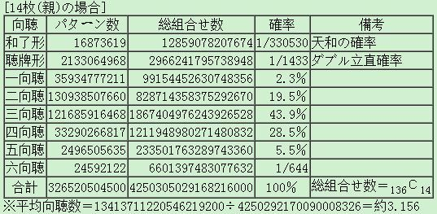
Basic idea of offense
CARD EFFECT THEORY
Shanten Number: How many cards do you need to shanten.
Effective Card: The card that can move forward the drawing hand.
Theoretically, you can go towards the direction of the drawing hand each time.
The game has the limitation of 8 points.
We should prevent the error winning.

Slide 8
Basic idea of offense
When shanten number > 2
Far from the status of the drawing hand, we directly reduce the Shanten Number.
Each play strategy selects the card that has the smallest Shanten Number and the largest number of effective card.
When shanten number ≤ 2
Further continuing to go towards the direction of the drawing hand is likely to be the error win.
Simulate enumeration with a search tree to find the branch that is most likely to be a valid winning hand.
When a winning hand is found in a branch, the point of a winning hand is counted, and finally the branch with the largest number of effective card is selected.

Slide 9
Stage optimization of offense
The shortages of the search tree
The level limitation on the search tree can lead to misjudgment.
Although the detection of the winning hand has judged the limitation of 8 point, but can not prevent the BOT to calculate some ways of the Shanten Number which can not reach 8 points, leading to its choice of a error win.

Slide 10
Stage optimization of offense
One-step greedy method
Whatever is the Shanten Number, the greedy method decides to go towards the drawing hand.
When a drawing hand was found that it is invalid, then play the card to increase the Shanten Number so as to try other paths.
Slight performance improvement.

Slide 11
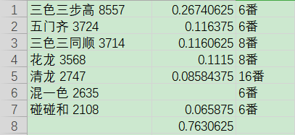
Stage optimization of offense
Principal's method
A total of seven kinds of winning hands commonly occurring over six points were found in the statistics of about 30,000 matches.
Rewrite the Shanten Number and effective card computation methods in seven kinds of winning, we only consider these types of winning hands.

Slide 12
Stage optimization of offense
Selection of the effective card
When choosing effective cards, there will be different kinds of effective cards equal, but the type of effective cards is not the same situation.
Decision of Kong
The score of Kong in the Chinese Standard Mahjong is higher, including double kong and so on.
In the case that the Shanten Number before Kong is equal the Shanten Number after Kong, we directly select Kong.

Slide 13
Defense
Algorithm
03.

Slide 14
Basic idea of defense
When there are still a variety of play options under the decision of offensive strategy, we add defensive strategy and consider the safest card with the highest safety factor to reduce the probability of discarding.
Added special rule. When the bot touches the last card on the tile wall, if it finds that the card is not legitimate, it will directly play the safest card.
In a defensive strategy, a card with a factor of safety is called a safety card.
Define the safety factor array score, traverse the cards in the discard pile, count the cards and get a score, which is the current safety factor.
We analyze the cards played by other players in the last three rounds. Those cards have the highest safety factor, and then we set the same safety factor for cards that are 3 away from these cards.
The closer to the current turn the card is, the safer it is.

Slide 15
Stage optimization of defense
There is a difference in precedence between a card that is played and a card that is 3 away from it.
Identical cards have higher priority and security than cards that are 3 away.

Slide 16
THANK YOU

